Slide 1
Analysis of Sales Methods and Recommendations
Vinayaka G N

Slide 2
Introduction
Purpose: Provide an overview of the analysis undertaken to evaluate the effectiveness of different sales methods.
Business Goals: Increase revenue and optimize sales strategies for the new product line.
Importance of Analysis: Emphasize the role of data-driven decision-making in maximizing the effectiveness of sales efforts.
Scope: Outline the key areas of focusing on data validation, exploratory analysis, and strategic recommendations.

Slide 3
Overview of the project
Project Context: Introduction to the new product line and the rationale for undertaking this analysis.
Data Summary: Overview of the critical data elements used in the analysis, including sales methods, revenue, and the number of products sold.

Slide 4
Data Validation and Cleaning
Validation Steps:
Confirmed week range (1 to 6) – No adjustment needed.
Standardized sales methods – Corrected mislabels.
Imputed missing revenue based on sales method.
Removed outliers in 'Years as Customer'.
Challenges Overcome:
Addressed 1,074 missing revenue entries.
Eliminated implausible customer tenure data.
Ensured all customer IDs were unique and formatted.
Post-Validation Summary:
Dataset now consists of 14,998 rows and 8 columns.
Enhanced data integrity for accurate analysis.

Slide 5
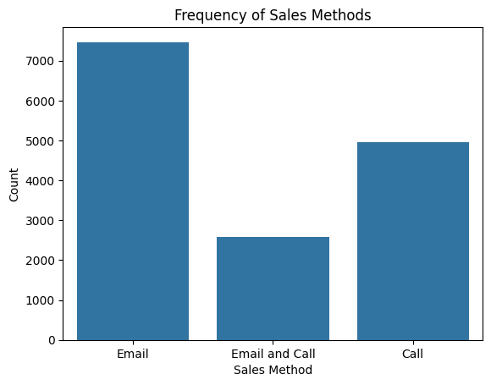
Exploratory Analysis – Single Variables
Visual 1: Bar Chart - Frequency of Sales Methods
Most common method: Email
Followed by: Call
Least used: Email and Call

Slide 6
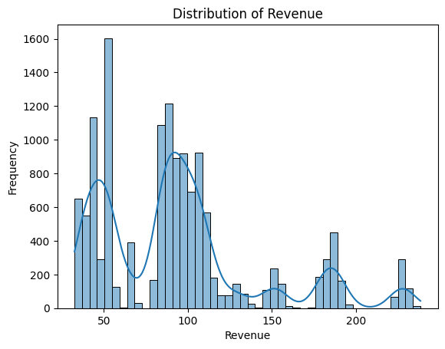
Visual 2: Histogram - Distribution of Revenue
Shows multimodal distribution
Peaks at regular intervals
Long tail indicating higher revenue transactions
Insights from Analysis
Sales Methods: 'Email' most used but 'Email and Call' generates higher revenue per sale.
Revenue Trends: Frequent lower revenue sales with occasional high-revenue peaks.

Slide 7
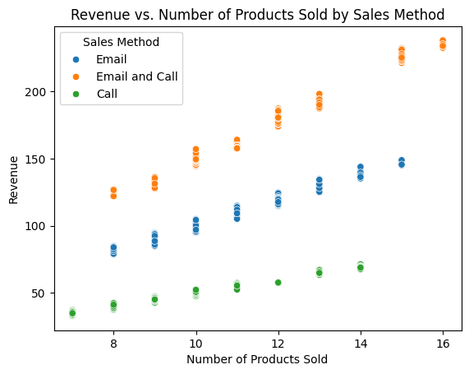
Exploratory Analysis – Multiple Variables
Visual: Scatter Plot - Revenue vs. Number of Products Sold
Differentiated by Sales Method (colors for each method)
Key Observations:
Positive correlation between number of products sold and revenue.
High revenue clusters mainly from 'Email and Call' method.
Variable revenue spread in 'Call' method.
Insights from the Scatter Plot:
'Email and Call' method effectively targets higher revenue
per sale, suitable for premium products.
'Call' method shows variability, indicating potential in
niche segments but requires strategic refinement.
General trend: More products sold, higher the revenue,
but effectiveness varies by sales method.

Slide 8
Key Findings
Effective Sales Method:
'Email and Call' generates the highest revenue per sale.
'Email' is most frequently used but less effective than combined methods.
'Call' method shows variability, potential with strategic enhancements.
Revenue Insights:
Positive correlation between sales volume and revenue.
Presence of set price points and occasional high-revenue sales.
Variability highlights the impact of sales strategy and product mix.

Slide 9
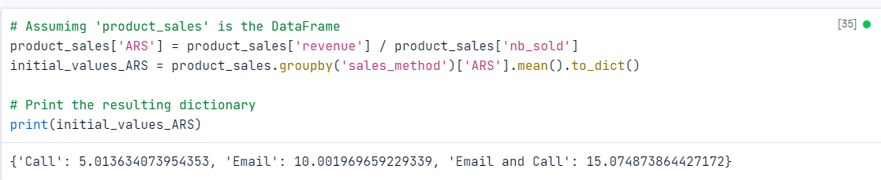
Metric to Monitor
Chosen Metric: Average Revenue per Sale (ARS).
Rationale:
Directly measures the financial success of each sale.
Reflects the efficiency and effectiveness of different sales methods.
Current Estimates:
ARS for 'Email': $10.00
ARS for 'Call': $5.01
ARS for 'Email and Call': $15.07

Slide 10
Recommendations
Prioritize 'Email and Call' Method:
Highest ARS at $15.07.
Suggests greater profitability per sale.
Optimize 'Email' Method:
Increase effectiveness through targeting and personalization.
Training and Resources:
Enhance training programs.
Allocate more resources to high-performing sales methods.
Additional Recommendations:
Evaluate the 'Call' method's efficacy.
Analyze high-value sales to replicate success.
Reassess pricing strategy for alignment with market trends.
Utilize ARS for customer segmentation.

Slide 11
Thank you

